Slide 1

ICIT2023
The 2nd International Conference on Intelligence of Things 2023
Ho Chi Minh City University of Technology (HCMUT)
University of Information Technology - VNUHCM
Enhancing Blockchain Interoperability through Sidechain Integration and Valid-Time-Key Data Access Control
Tuan-Dung Tran Kiet Anh Vo Nguyen Binh Thuc Tram Ngan Nguyen Bui Kim Phan The Duy Van-Hau Pham

Slide 2
Table of contents
01
02
03
04
Introduction
Proposed system
Implementation
Conclusion
Notes:
Our presentation will be divided into four main parts:
Intro: In this section, we will provide an overview of the blockchain technology, properties of blockchain and Real-world industry blockchain applications. Importantly, we will outline the key motivations behind our proposed system and discuss about the research objectives in our study.
Pro sys: Here, we will delve into the core of our research, present a detailed explanation of the proposed system for enhancing blockchain interoperability, cross-chain data transfer and introduce the concept of oracle technology in blockchain, the most important component in our framework. Additionally, we will discuss about data access control scheme using valid-time-key.
Impl: This section will offer insights into the practical implementation of our proposed system, include Experimental environment info, various scenarios for performance testing, experimental results.
Conclusion: Lastly, we will conclude our presentation by summarizing the key contributions of our study and discuss about future works

Slide 3
01
Introduction
ICIT2023

Slide 4
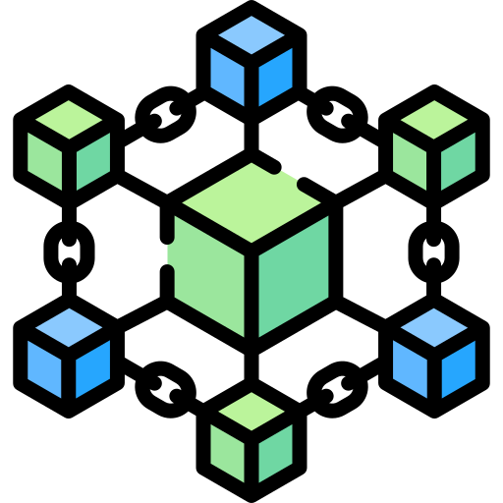
Blockchain
1
2
3
4
5
6
Basic concept
distributed digital ledger of cryptographically signed transactions that are grouped into blocks
healthcare
supply chain
government
transparency
consensus
security
decentralization
immutability
INDUSTRIES
financial services
insurance
retail
Notes:
Each block is linked to the previous one after validation and undergoing a consensus decision. Basically, it enable a community of users to record transactions in a shared ledger within that community, and no transaction can be changed once published.
The properties of blockchain typically include:
Blockchain can be useful for various real-world industries like:… Specially, Healthcare context is the main motivation in our study

Slide 5
Smart contract
1
2
3
4
5
6
Defined
digital contract allowing terms contingent on decentralized consensus that is self-enforcing through automated execution
Trust
Cost savings
Challenges
Benefits
Complex interoperability challenges across different blockchain networks and traditional systems
Efficiency
Autonomy
Accuracy
Security
Notes:
Smart contracts can facilitate exchanging money, property, service, or anything of value in an automated way.
Smart contracts offer a variety of benefits, including:
However, blockchain has to face some challenges such as Interoperability Challenges for example: how to exchange 2 different cryptocurrency like bitcoin vs Ethereum coin (ETH) or how a blockchain can get data from external world

Slide 6
Background
1
2
3
4
5
6
Hospital implements Private blockchain network
Entities management (doctor, patient)
Data management (patient records)
Streamlined Medical billing processing
Enhanced Supply chain management
Has not enough Full nodes
Compromised Data Integrity
Higher cost
More secure
Have a crucial role, store a complete copy of the blockchain
Lower cost
Less secure
Notes:
In the background of our study, healthcare context, A hospital …This application can be use for
However, this hospital’s PrB has not enough Fullnodes (). The more FN higher cost and the system more secure. That also mean the less FN, we have lower cost but system less secure. This issue leads to likelihood of …

Slide 7
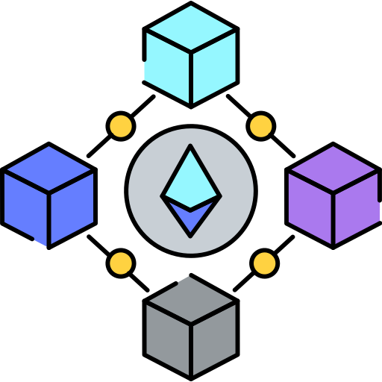

Solution
1
2
3
4
5
6
The evidence of data integrity (hash string) be stored on the Public blockchain
Electronic Medical Record (EMR) of Patients can be protected from malicious modifying
How does data transfer between different blockchains?
SIDECHAIN
Notes:
When we want to check the integrity of data, we need to have an evidence, audit proof to verify, it can be a hash string from hashing entire data at a reliable time. And to make the evidence trustful and immutable, it can be stored on the Public blockchain. With this
But the problem is…, to resolve we introduce the concept of sidechain

Slide 8
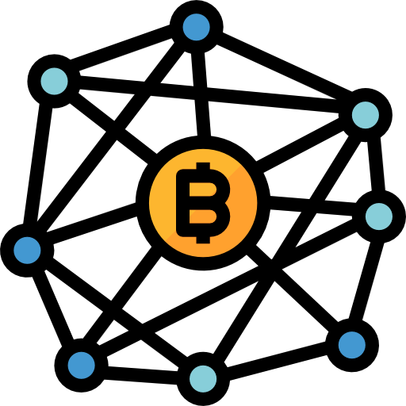
Sidechain
1
2
3
4
5
6
Cross-chain solution: a separate blockchain that runs in parallel, allows transferring data or asset between distinct blockchains
SIDECHAIN
Notes:
Parallel to the main blockchains
We will discuss the details of sidechain architecture in the proposed system part

Slide 9
Data access control
1
2
3
4
5
6
Context
Doctor requests to access EMR of patient
01
Authentication
Verify doctor’s identifier
Blockchain
02
Authorization
Check doctor’s access rights
03
Timeline
How long can doctor access
Valid time key (VTK)
04
Termination
Revoke doctor’s access rights
Notes:
beside the integrity of data, we also consider about data access control with the scenario that ...
To achieve DAC, we have to verify & check. And blockchain can be use for …
Additionally, the other two essential aspects should be address are … and we will introduce VTK schedule to address them

Slide 10
02
Proposed system
ICIT2023

Slide 11
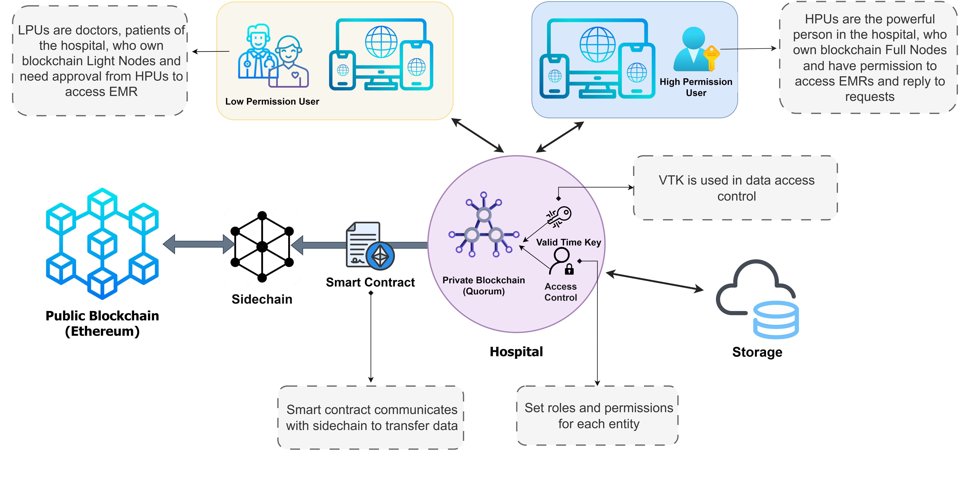
Overview diagram
1
2
3
4
Notes:
In there, the system have key components as follows:
Private blockchain of Hospital using Quorum blockchain
Role-based entities of hospital include: LPU & HPU …
Storage that store EMR
Public blockchain that stores audit proof of EMR, using ethereum
And sidechain – an intermediary between two blockchain

Slide 12
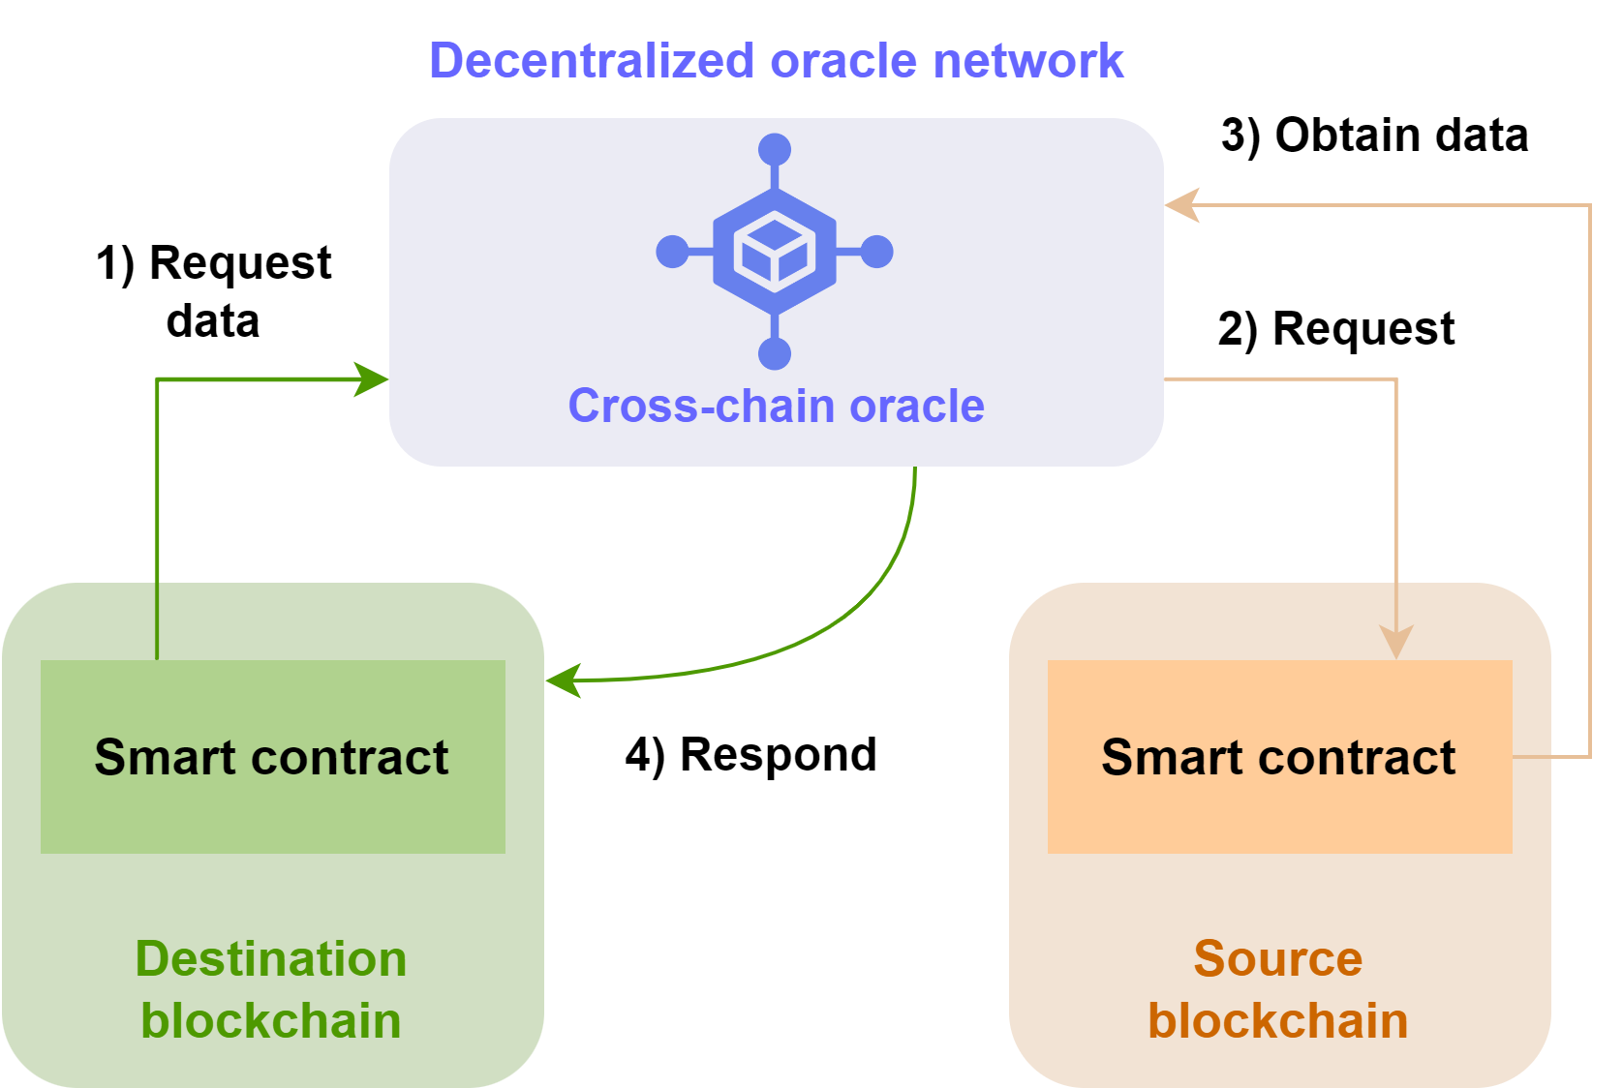
Our sidechain architecture
1
2
3
4
is a decentralized oracle network
Oracles
Serve as bridges between blockchains and the real world, retrieve external data into the blockchain and enable the seamless transmission of internal blockchain data to the external world.
In sidechain
Each oracle receives data requests from user, enables the oracle contract to create the secure communication and transfer of external data to and from the blockchain network.
Notes:
This figure simulates workflow of an oracle

Slide 13
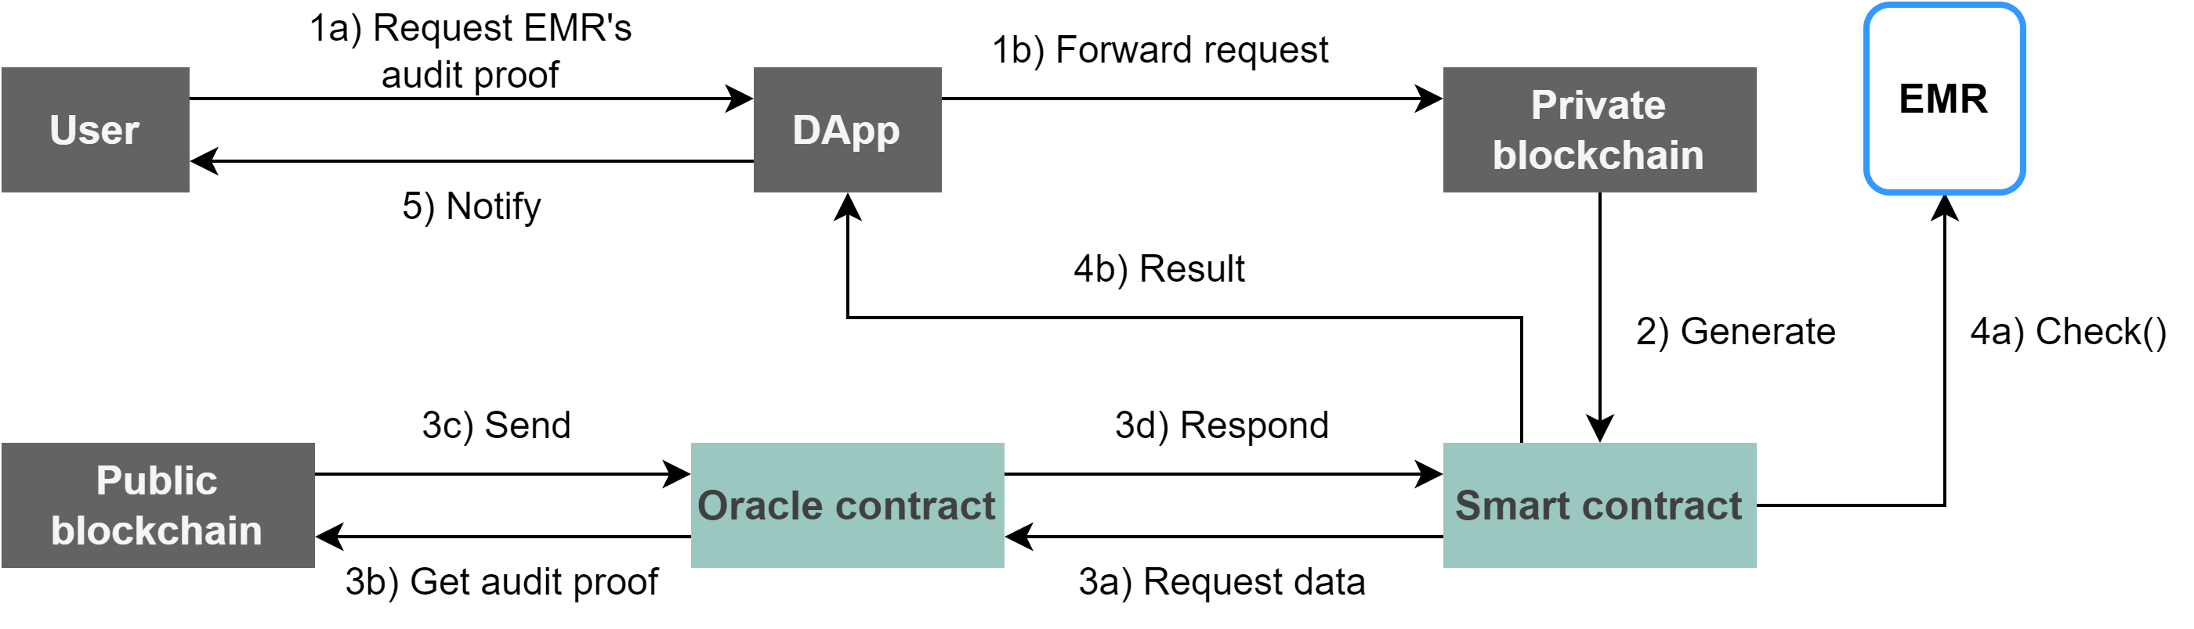
Cross-chain data transfer process
1
2
3
4

Slide 14
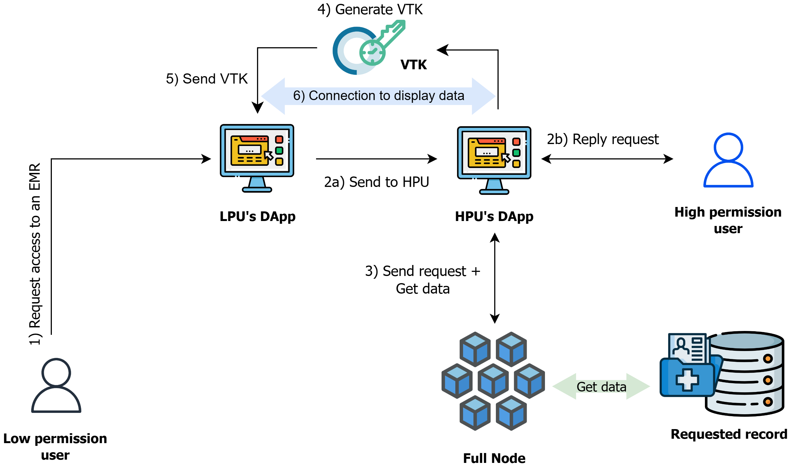
VTK Data access control
1
2
3
4

Slide 15
03
Implementation
ICIT2023

Slide 16
Experimental environment
Virtual machine | CPU | Hard drive | RAM | OS | Task
VM1 | 4-core | 60 GB | 16 GB | Ubuntu 22.04 | Quorum
VM2 | 4-core | 60 GB | 8 GB | Ubuntu 22.04 | Sidechain
VM3 | 4-core | 60 GB | 8 GB | Ubuntu 22.04 | Ethereum
Notes:
We use 3 VM for simulating 2 blockchain Quorum, Ethereum and Sidechain, with same CPU, Hard dive and OS

Slide 17
Performance Evaluation (1/2)
Object | Transaction | CPU usage | Gas | USD
Blockchain entities | Register Manager | 66.29% | 46407 | 4.46
 | Register Doctor | 66.17% | 46378 | 4.45
 | Resister Patient | 66.12% | 46378 | 4.45
EMR | Store data | 62.22% | 92664 | 8.90
Data access control | Grant Permission | 66.82% | 161275 | 15.48
 | Revoke Permission | 66.60% | 30261 | 2.91
Audit proof | Query | 73.31% | 229851 | 22.07
CPU usage & Cost consumption
1 USD ≈ 10415 Gas
Notes:
For performance evaluation, we conducted various scenarios and got results about CPU usage & cost consumption. We have 4 object, performed some transactions for each of them. Query audit proof is the most complex activity, so it consumes the most resources.

Slide 18
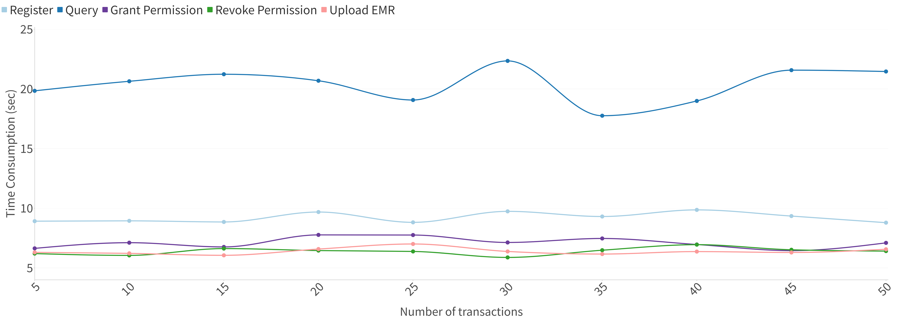
Performance Evaluation (2/2)
Time consumption
Conduct total 50 measurements for each transactions
Notes:
We also measure time consumption of those transactions. The results are in seconds unit

Slide 19
04
Conclusion
ICIT2023

Slide 20
Future works
Enhance system performance
Apply VTK scheme for external blockchain data
Address mutable data scenarios
Conclusion
Implement the system on a test network comprised of several blockchain platforms
Propose a novel cross-chain system for verifying the integrity of data through the Sidechain of oracle architecture, incorporating data access control by Valid Time Key

Slide 21

ICIT2023
Thank you for listening

